Slide 1
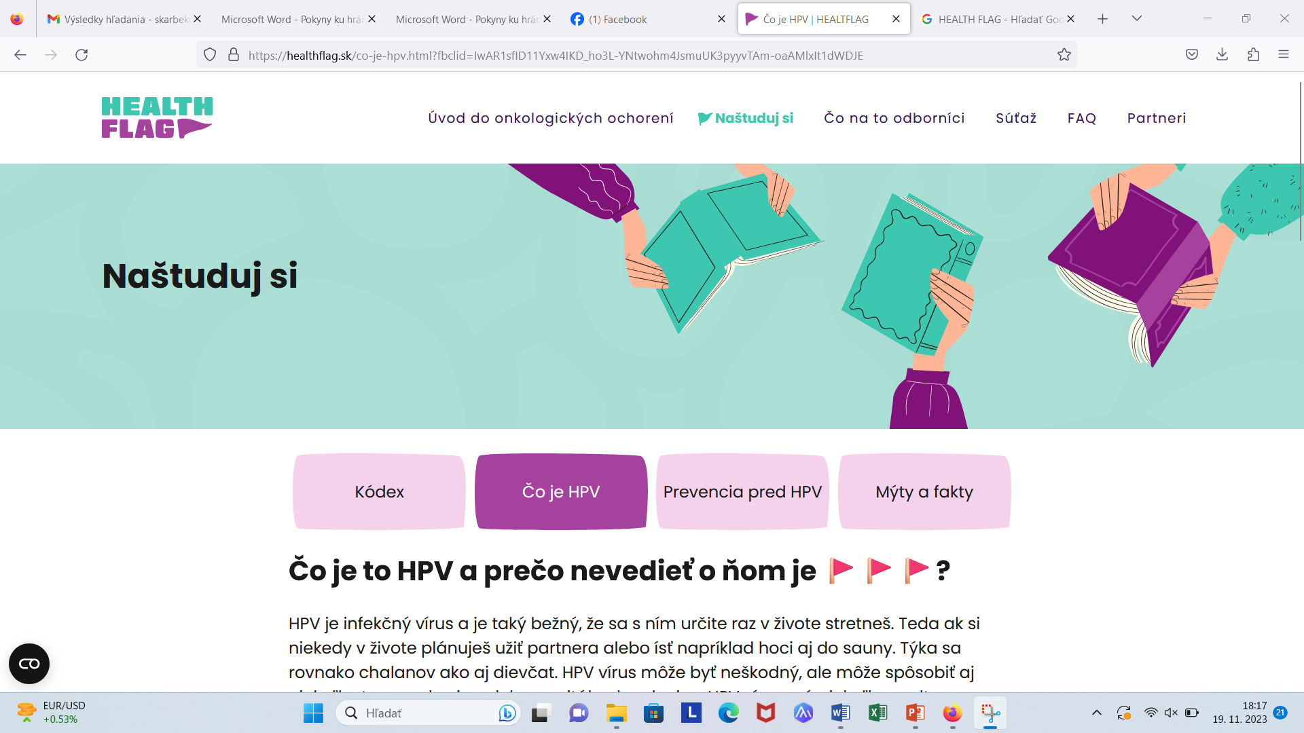
https://healthflag.sk/co-je-hpv.html?fbclid=IwAR1sfID11Yxw4IKD_ho3L-YNtwohm4JsmuUK3pyyvTAm-oaAMlxIt1dWDJE

Slide 2
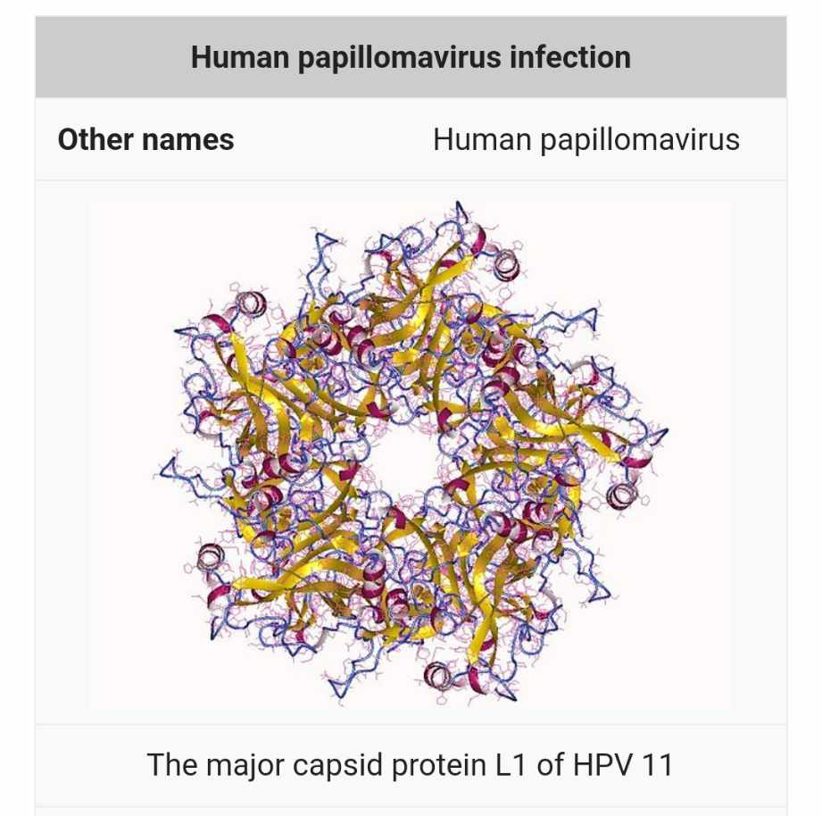
HPV je DNA vírus ☺

Slide 3
